Slide 1


AVIONICS AND RECOVERY

Slide 2
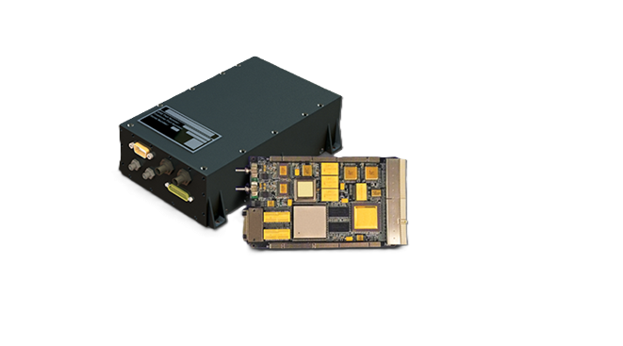

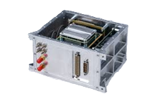
WHAT IS AVIONICS?
WHAT CAN
AVIONICS DO?
->Avionics refers to the electronic systems used in aircraft, satellites, and, in our case, rockets. It is the central nervous system that manages all critical flight operations.
Avionics also handles triggering of recovery mechanisms like parachute deployment at precise altitudes or conditions. It ensures the rocket and payload can be safely retrieved after launch.
Navigation: Determines the vehicle’s position, direction, and speed using instruments like GPS, gyroscopes, and accelerometers.
Communication: Enables data exchange between the vehicle and ground stations or other systems through radios and antennas.
Monitoring and Instrumentation: It tracks system parameters such as temperature,pressure,altitude, and fuel used.

Slide 3

WHY DO WE NEED AVIONICS?
Altitude Detection: Avionics systems use sensors like barometers, GPS, and accelerometers to measure the rocket’s altitude throughout the flight. This allows the system to accurately detect the apogee (highest point) and trigger events such as parachute deployment or stage separation at the correct time, ensuring a safe and controlled descent.
Stability Monitoring: The avionics continuously track the rocket’s orientation (pitch, roll, yaw) and acceleration using IMUs and gyroscopes. By analyzing these readings, the system can detect any instability or deviation from the intended flight path and send corrective commands to fins, thrust vector controls, or reaction wheels to maintain stable flight.
Failsafe Recovery: Avionics include redundant circuits, backup batteries, and multiple sensors to ensure reliability even if one component fails. In case of a malfunction or loss of signal, the system can automatically trigger parachute deployment or switch to a backup control mode, preventing mission failure and aiding rocket recovery.
Power Management: The avionics unit regulates and distributes electrical power from the onboard battery or power source to all systems — sensors, computers, communication modules, and actuators. It ensures stable voltage levels, monitors power usage, and protects components from overloads or short circuits, allowing all subsystems to operate efficiently throughout the mission.
\

Slide 4
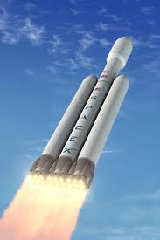
FALCON 9 LANDING-POWER OF AVIONICS
When SpaceX aimed to make rockets reusable, its biggest challenge was landing the Falcon 9 booster upright after launch. Controlling a 40-meter rocket falling from space and landing it on a tiny drone ship seemed nearly impossible.
The success came from advanced avionics — the rocket’s brain and nervous system. Falcon 9 uses triple-redundant flight computers, inertial sensors (IMUs), GPS, and autonomous guidance software that calculate its position and orientation hundreds of times per second.
As the rocket descends, avionics instantly corrects for wind, drag, and tilt by adjusting engine angles (gimbaling). Even if one computer fails, backups take over seamlessly.
After several failed attempts, SpaceX achieved its first successful landing in December 2015, revolutionizing spaceflight. This was possible only through precise control, real-time corrections, and reliable avionics, proving it’s the key to safe and reusable rockets.

Slide 5
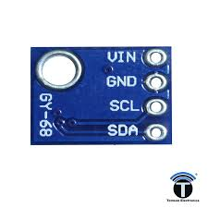
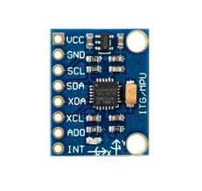
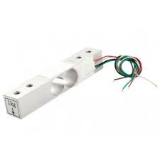
BMP180
BMP180 BAROMETRIC SENSOR
MPU6050 IMU (INERTIAL MEASUREMENT UNIT)
Measures atmospheric pressure to calculate the rocket's current altitude with high precision.
Combines a 3-axis gyroscope and a 3-axis accelerometer to track rotation, orientation, and acceleration during flight.
KEY SENSING COMPONENTS: GATHERING FLIGHT DATA
MPU6050
LOAD CELL
WHY??
Used primarily on the test stand to measure the thrust produced by the rocket motor during static fire tests.
These sensors mandatorily help in the collection of data which can be used to constantly monitor the state of the rocket .
It can help in the stiumulation of many necessary mechanisms in robotics such as parachute deployment at a certain height,etc.
LOAD CELL

Slide 6



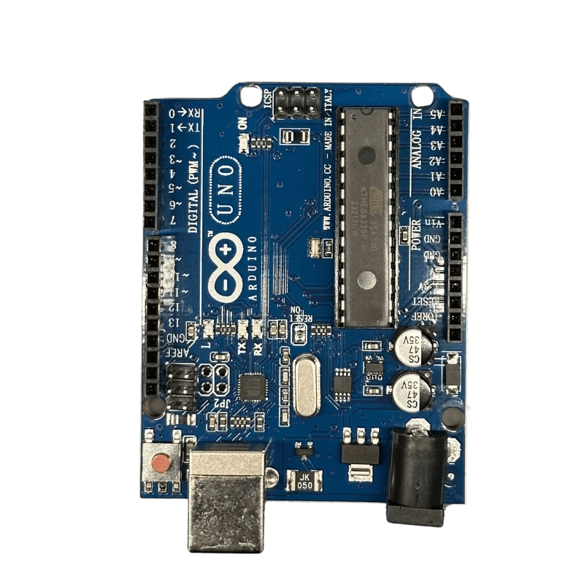
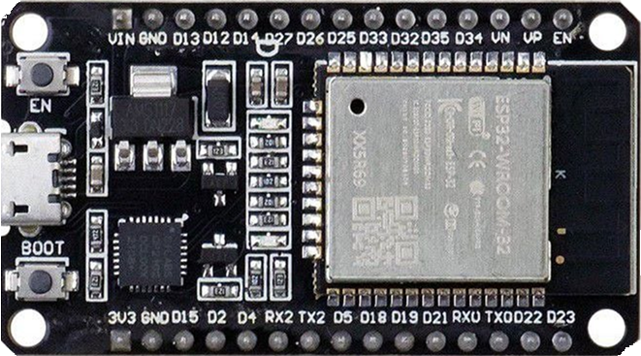


THE FLIGHT CONTROL CORE: MICROCONTROLLERS
1
ARDUINO UNO R3
2
ESP32 MICROCONTROLLER
An excellent, robust platform for initial development and proof-of-concept testing due to its simplicity, extensive community support, and ease of use for prototyping sensor integration.
A powerful upgrade, often used for flight, featuring built-in Wi-Fi and Bluetooth capabilities. This allows for telemetry transmission and remote configuration, crucial for advanced hobbyist projects.

Slide 7
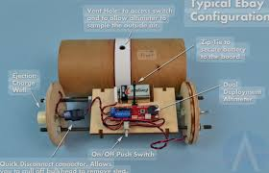
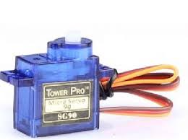
ACTUATORS: TRANSLATING COMMANDS TO ACTION
1
SERVO MOTORS (RECOVERY)
2
PYROTECHNIC CHARGES (ALTERNATIVE)
We utilise a servo motor for the dummy parachute deployment mechanism. The servo moves a linkage or pin to release the parachute hatch precisely at apogee, initiated by the flight computer.
High-power rockets often use small pyrotechnic charges, which are also actuators, to pressurise the recovery bay and eject the nose cone. Servos offer a reusable, non-explosive alternative for testing and smaller rockets.

Slide 8
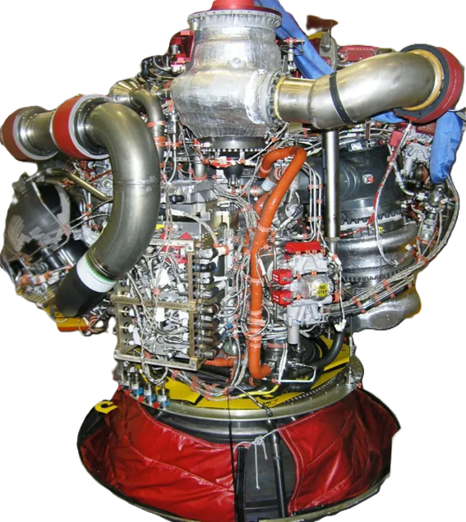
Conclusion
Successful rocketry demands a tightly integrated avionics system where sensors, microcontrollers, and actuators work in perfect synchronisation. This ensures a safe launch, accurate data acquisition, and reliable recovery.
Example:-Hands-on demonstration of programming the MPU6050 and triggering the servo for a test deployment.
09

Slide 9

THANK
YOU

